Slide 1
Credit score Analysis
Isaac Afedia

Slide 2
Problem Statement:
Develop a machine learning model to accurately predict the credit score of customers based on their financial and personal information. The model should be able to handle large amounts of data, account for different credit reporting agency models, and be scalable for use in real-time credit scoring applications. The goal is to improve the accuracy of credit scores.

Slide 3
Dataset Description:
The Credit Score Classification dataset from Kaggle is a publicly available dataset that contains information on customer credit scores and other relevant attributes. The dataset contains a total of 100,000 records, each with 27 features, including the customer's ID, Name, AGE, Annual income, and Occupation etc.
The target variable in this dataset is a binary classification label indicating whether a customer is likely to default on their loan (represented by a label of '1') or not (represented by a label of '0'). The dataset is often used for building predictive models to identify high-risk customers and improve lending decisions.
The Credit Score Classification dataset is a valuable resource for data scientists and machine learning practitioners interested in developing models for credit risk assessment, fraud detection, and other financial applications. It provides a real-world example of a common business problem and a means to test and refine machine learning algorithms.

Slide 4
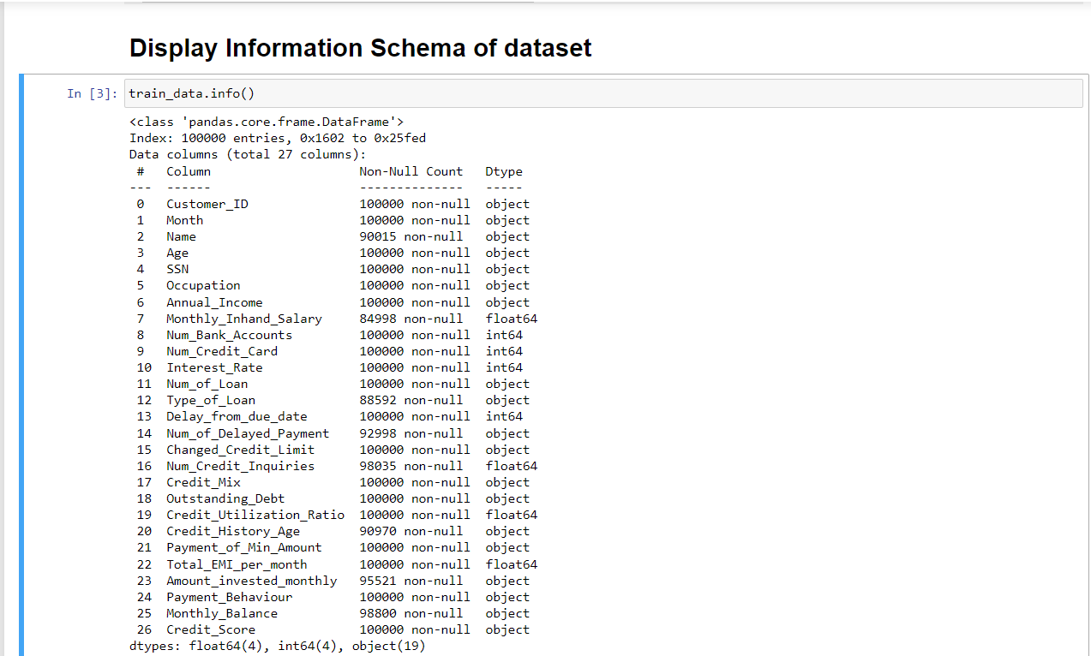
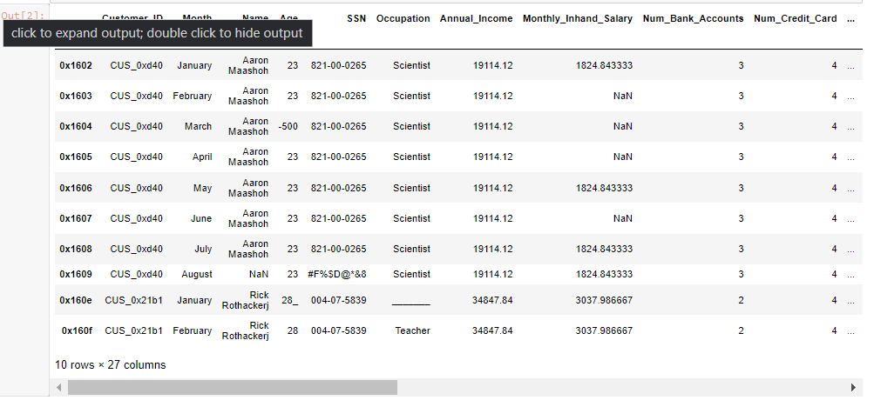
Features and Rows

Slide 5
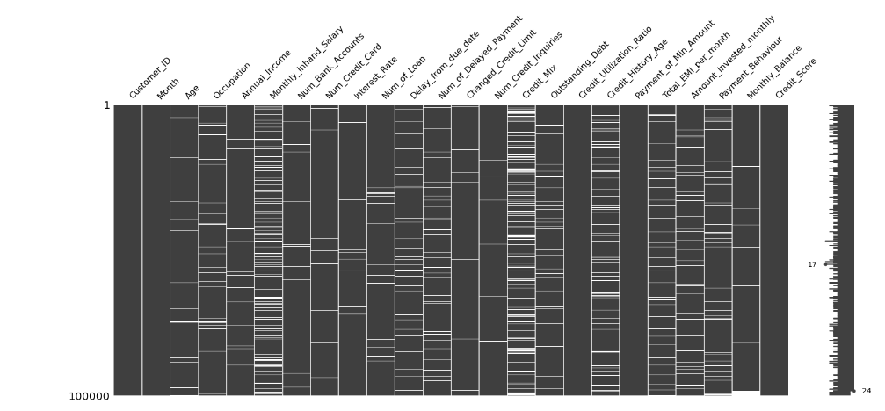
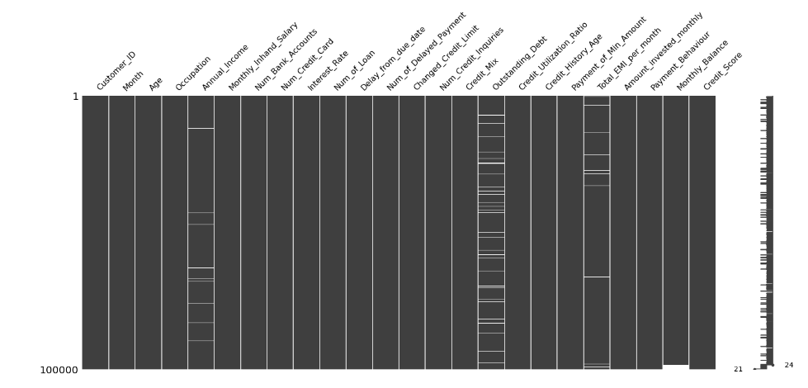
Missing Values in dataset
Before Cleaning
After Cleaning

Slide 6
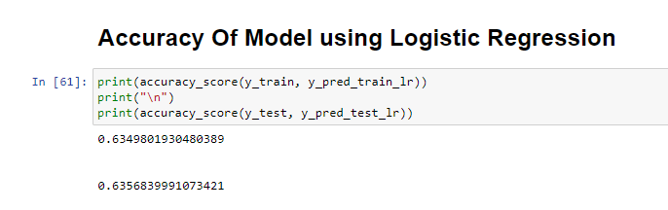
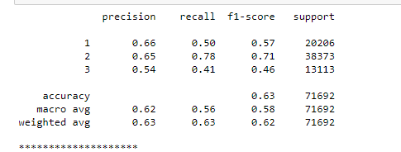
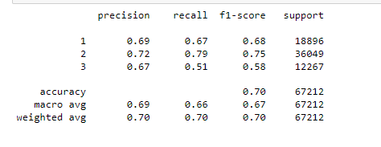
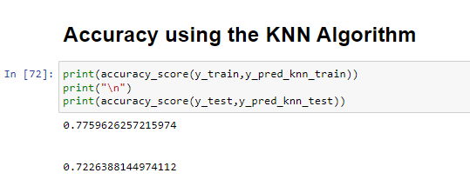
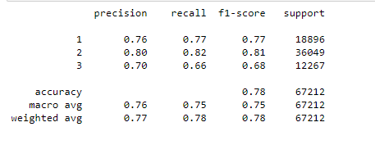
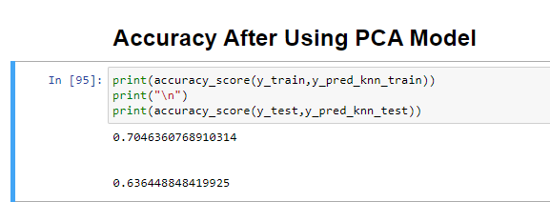
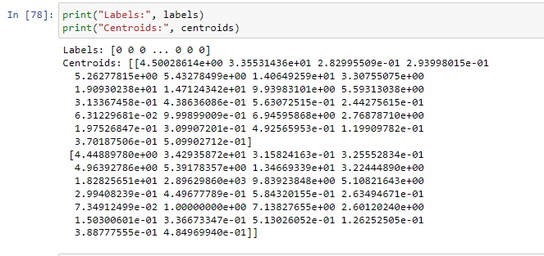
Results of Datasets using different techniques
Logistic Regression
PCA Model
KNN Model
Centroids using K Means

Slide 7
Conclusion:
While Performing the Logistic Regression we obtained the Accuracy of the model to be 0.6349801930480389 to be precise.
While Performing the KNN with n value as 2, we obtained the Accuracy of the model to 0.7759626257215974 to be precise.
We can say that accuracy is increased to 0.7046360768910314 by doing the PCA reduction .
Therefore , We can say out of all KNN with n=2 , Gives us the best accuracy rate.

